Slide 1
Project Title: Okoloma Land Fencing
Charter Template
Business Case/ Objectives:
SPDC land in front of Okoloma FLB is currently prone to encroachment with the current level of urbanization around the area. Fencing off the area will help secure SPDC land and eliminate the chances of encroachment thus preventing possible legal tussles that may have ensued.
Potential Benefits & Measurement:
Secure SPDC land
Prevent encroachment and prevent legal tussle
Project Scope/Actions :
Secure Management approval
Site Assessment Report Issued
Draft scope of work ready
CMT Appointed
Contracting strategy agreed
Cost estimates ready
Part A approved
ITT issued
Contract Awarded
Kick-off meeting held
Pre-mob/ Mob vendor
Site installation.
Handover
Vendor Demobilized
Critical Success Factors:
Community FTO
Asset Leadership/Stakeholder Support
Project Sponsor: Florence / Ikechukwu
Implementation Lead: Ebere Onoh
Project Team:
Oluwasegun Ajagbe
High-level Timeline:
L0-L1: May 2018
L2: May 2018
L3: Aug. 2018
L4: Aug. 2018
L5: 30 Oct. 2018
Initiative End (30 Oct. 2018)

Slide 2
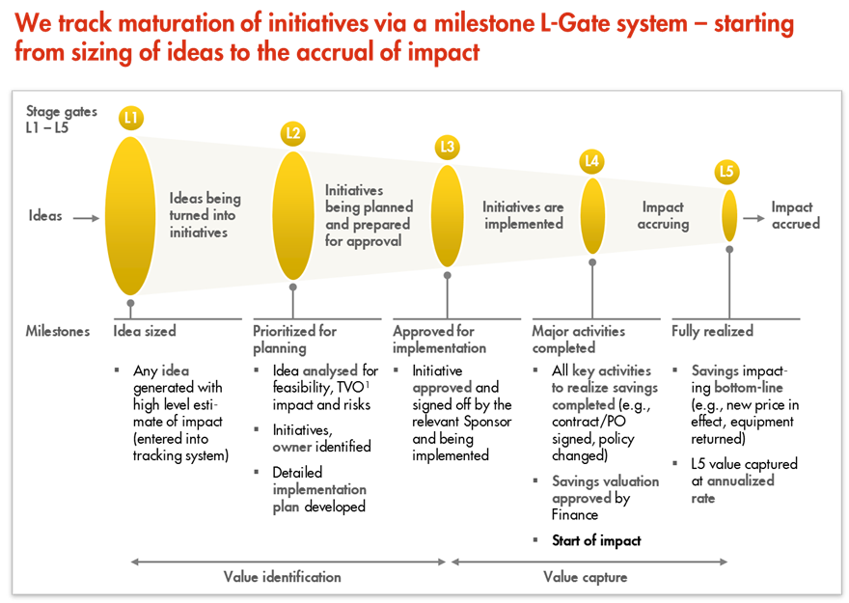
L1 – L5 Gates

